Slide 1
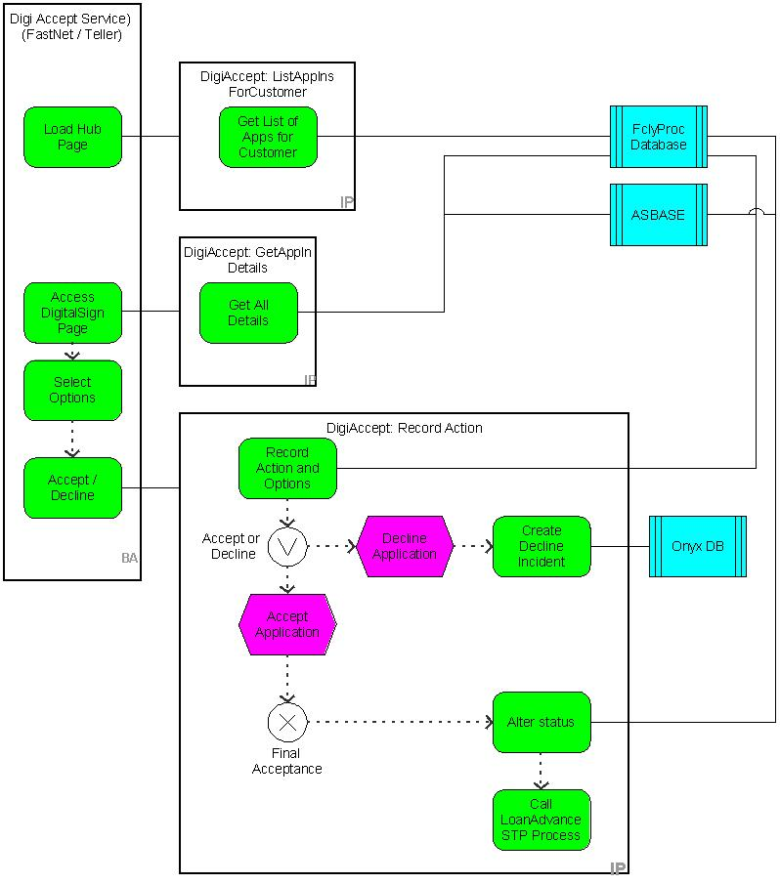
Loan Top Ups - Digital Acceptance
Customers can Top-Up an existing Home Loans or Personal loans by digital accepting the documents in Fast Net Classic

Slide 2
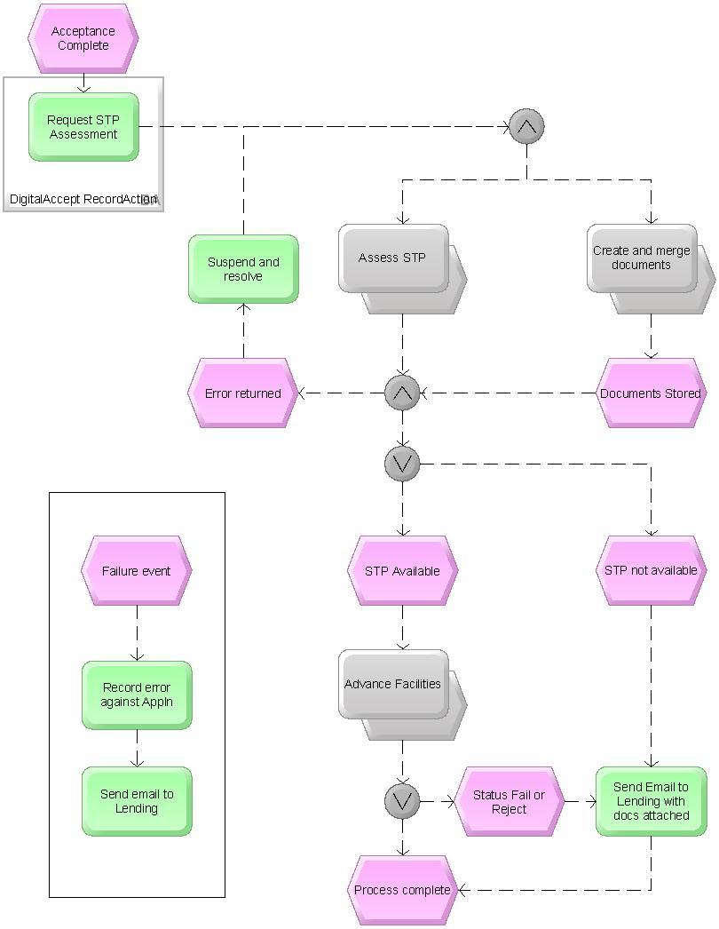
Loan Top Ups - Digital Acceptance

Slide 3
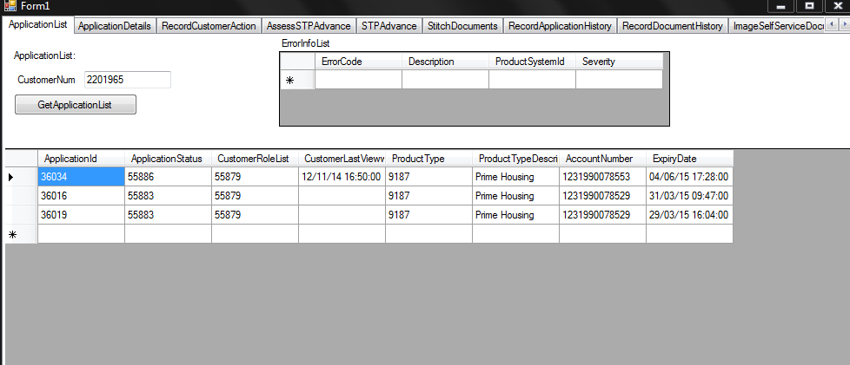
Loan Top Ups - Digital Acceptance
Application List Service :

Slide 4
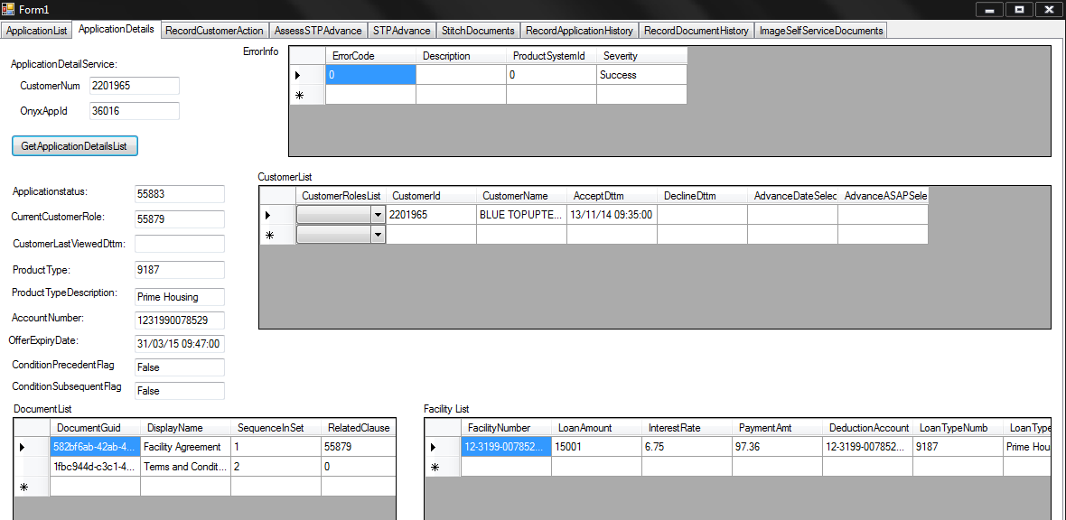
Loan Top Ups - Digital Acceptance
Application Details Service :

Slide 5
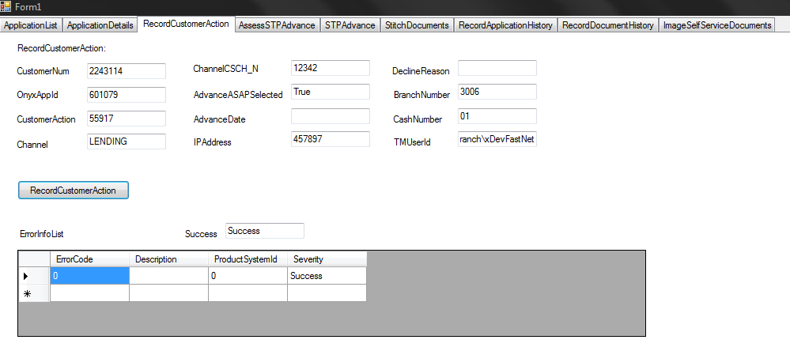
Loan Top Ups - Digital Acceptance
Record Customer Action

Slide 6
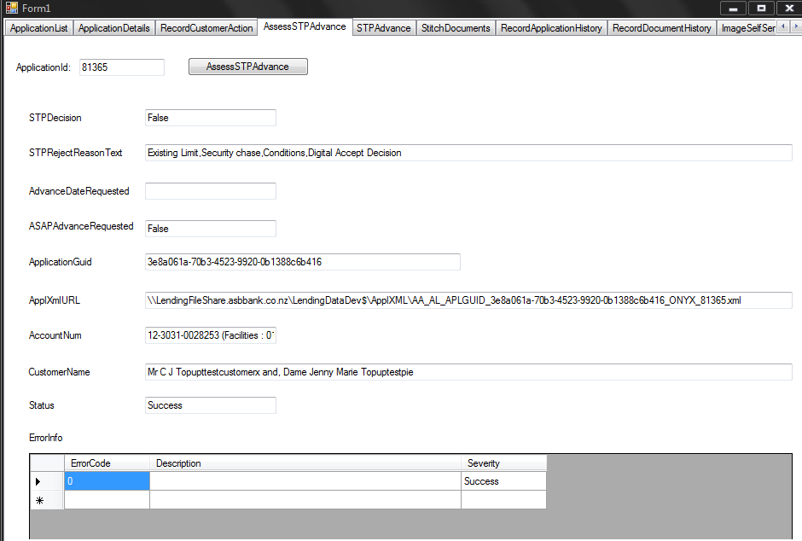
Loan Top Ups - Digital Acceptance
Assess STP Advance :

Slide 7
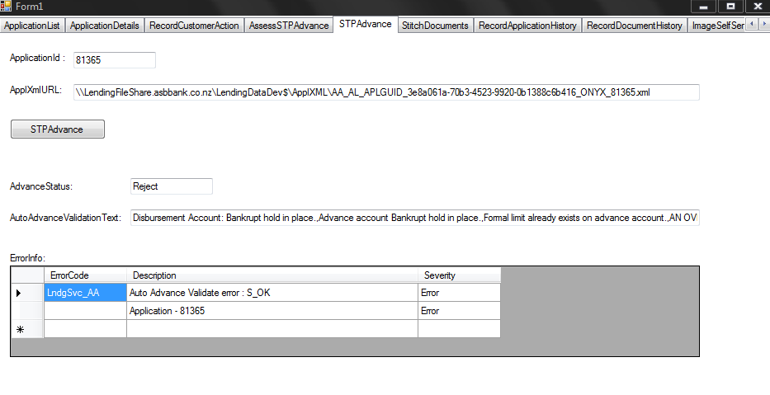
Loan Top Ups - Digital Acceptance
STP Advance :

Slide 8
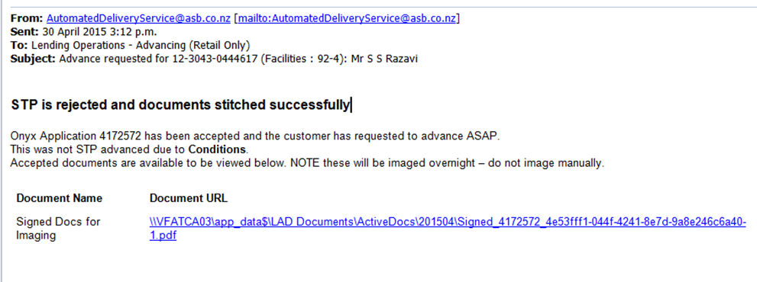
Loan Top Ups - Digital Acceptance
STP Advance Reject and Loan Documents Stitched successfully :

